Slide 1
RESTAURANT MANAGEMENT SYSTEM
Submitted by,
D.Angel

Slide 2
INTRODUCTION
A Mini project on restaurant billing system using Java.
It has 3 classes :
TestMain
Customer
ManageFood

Slide 3
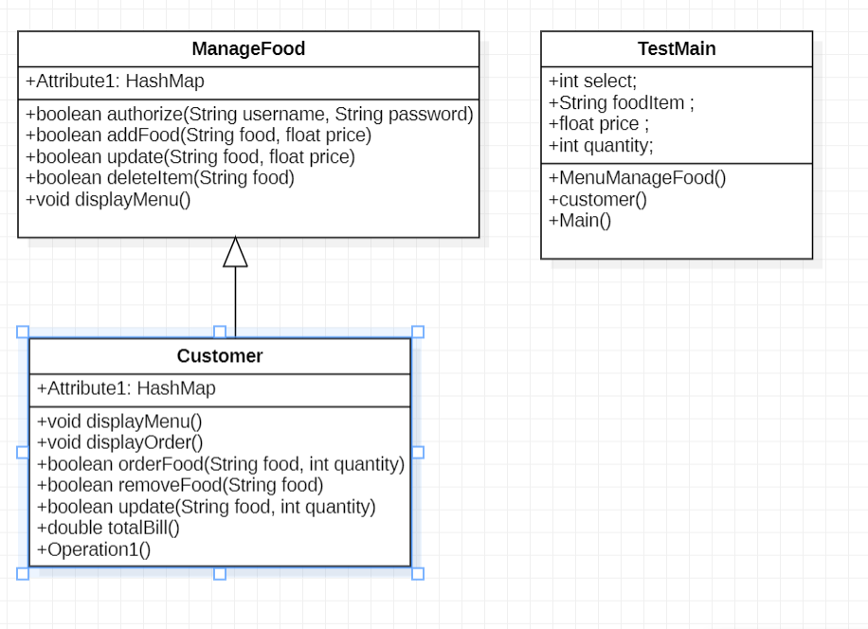
CLASS UML DIAGRAM

Slide 4
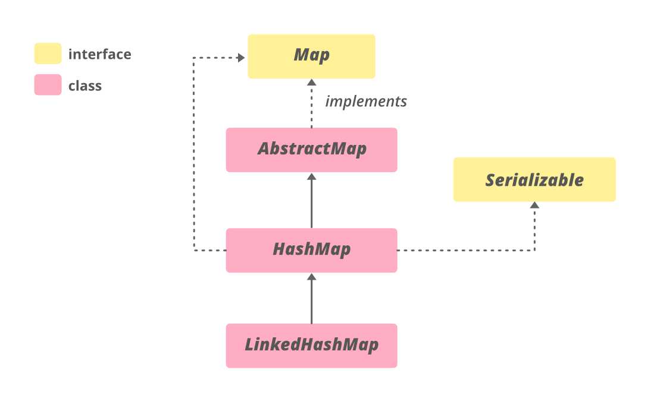
CONCEPTS USED IN CODE
HashMap: The HashMap class of the Java collections framework provides the functionality of the hash table data structure. It stores elements in key/value pairs. Package:java.util.HashMap.

Slide 5
.
SWITCH STATEMNET: The switch expression is evaluated once.The value of the expression is compared with the values of each case.If there is a match, the associated block of code is executed.
If STATEMENT: The Java if statement is the most simple decision-making statement. It is used to decide whether a certain statement or block of statements will be executed or not i.e if a certain condition is true then a block of statement is executed otherwise not

Slide 6
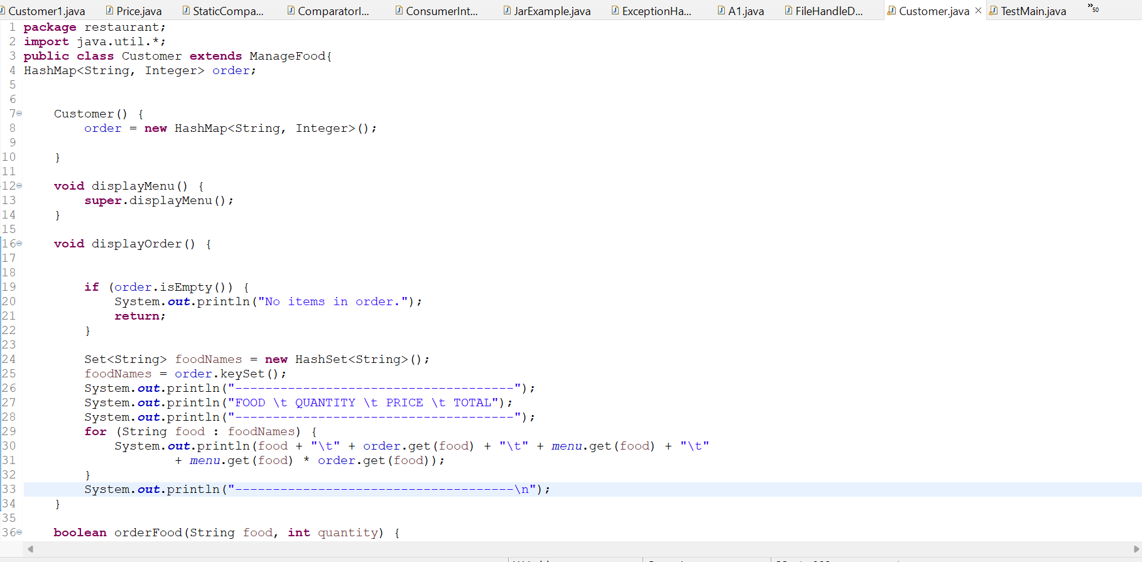
SOURCE CODE:

Slide 7
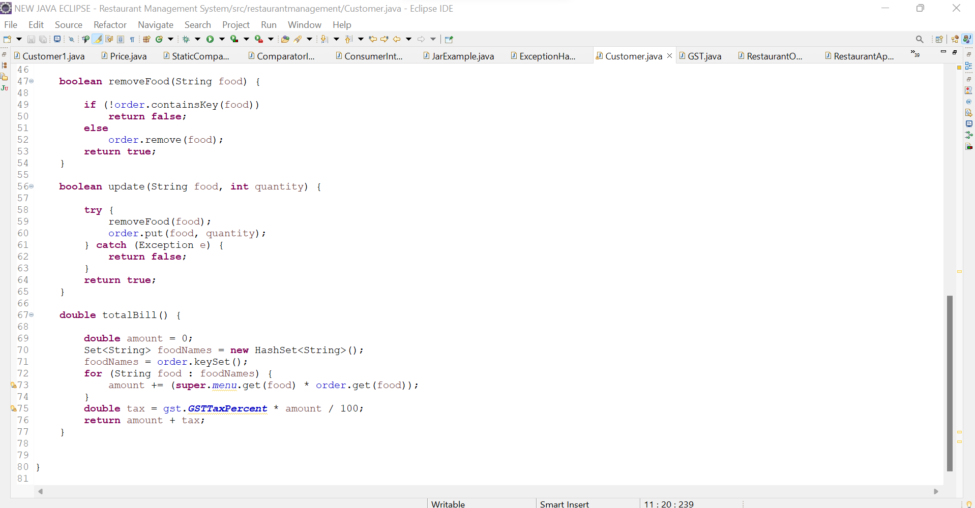

Slide 8
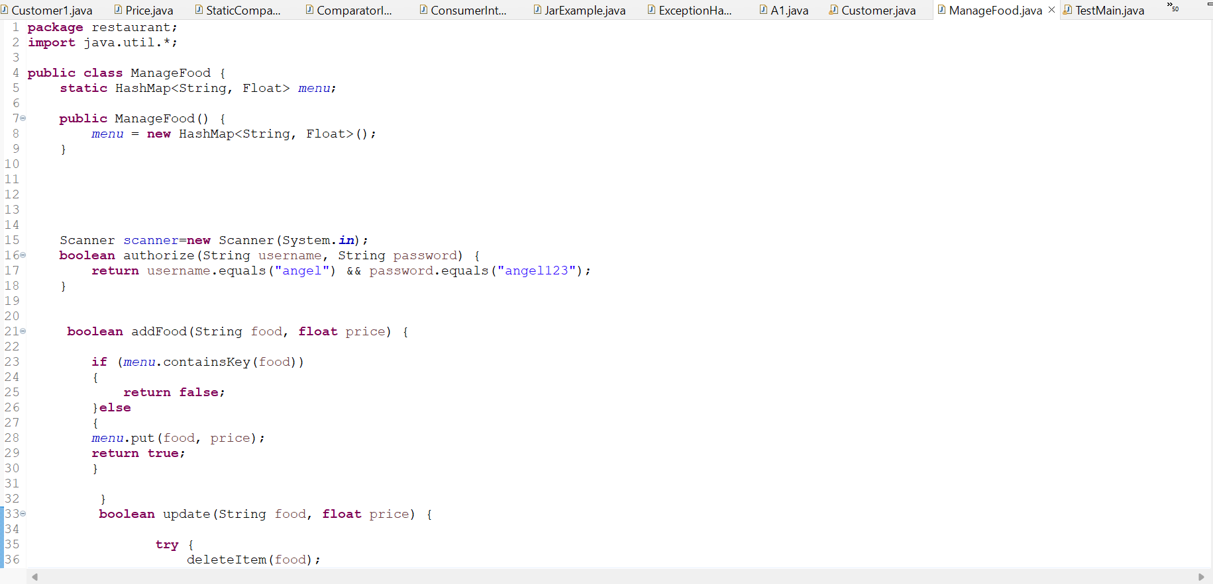

Slide 9
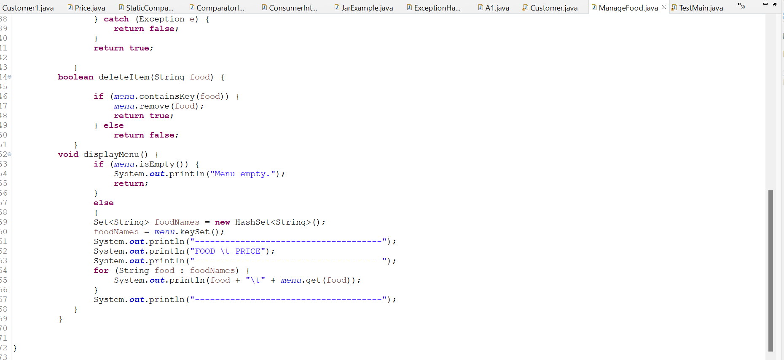

Slide 10
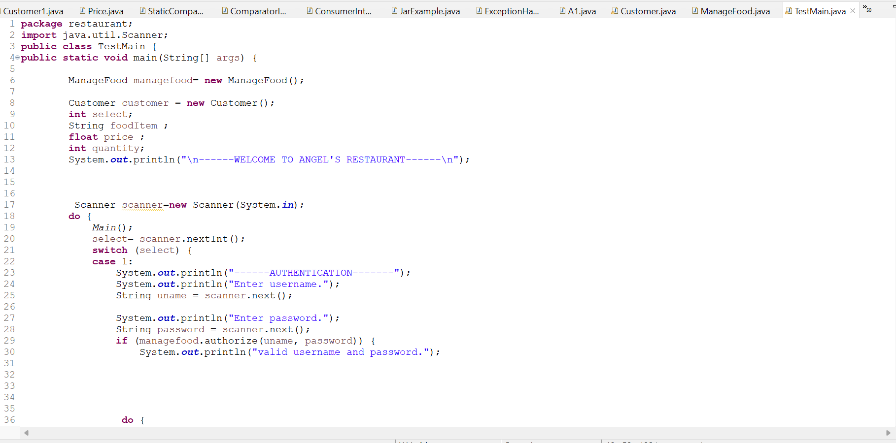

Slide 11
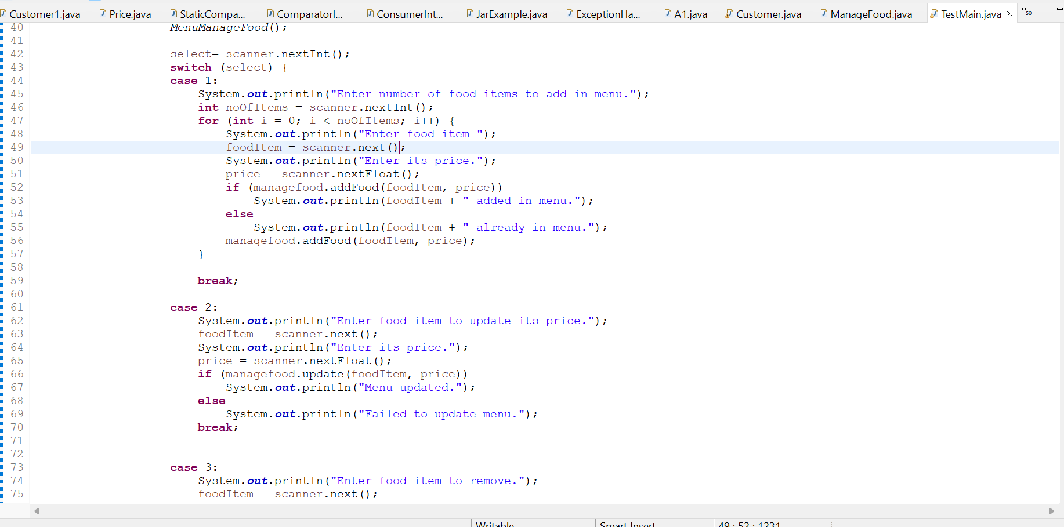

Slide 12
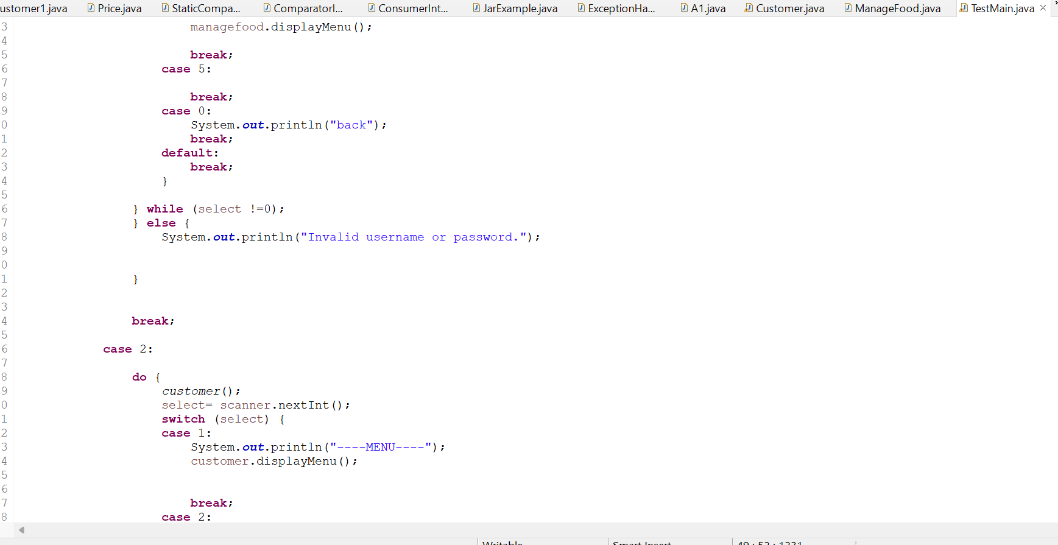

Slide 13
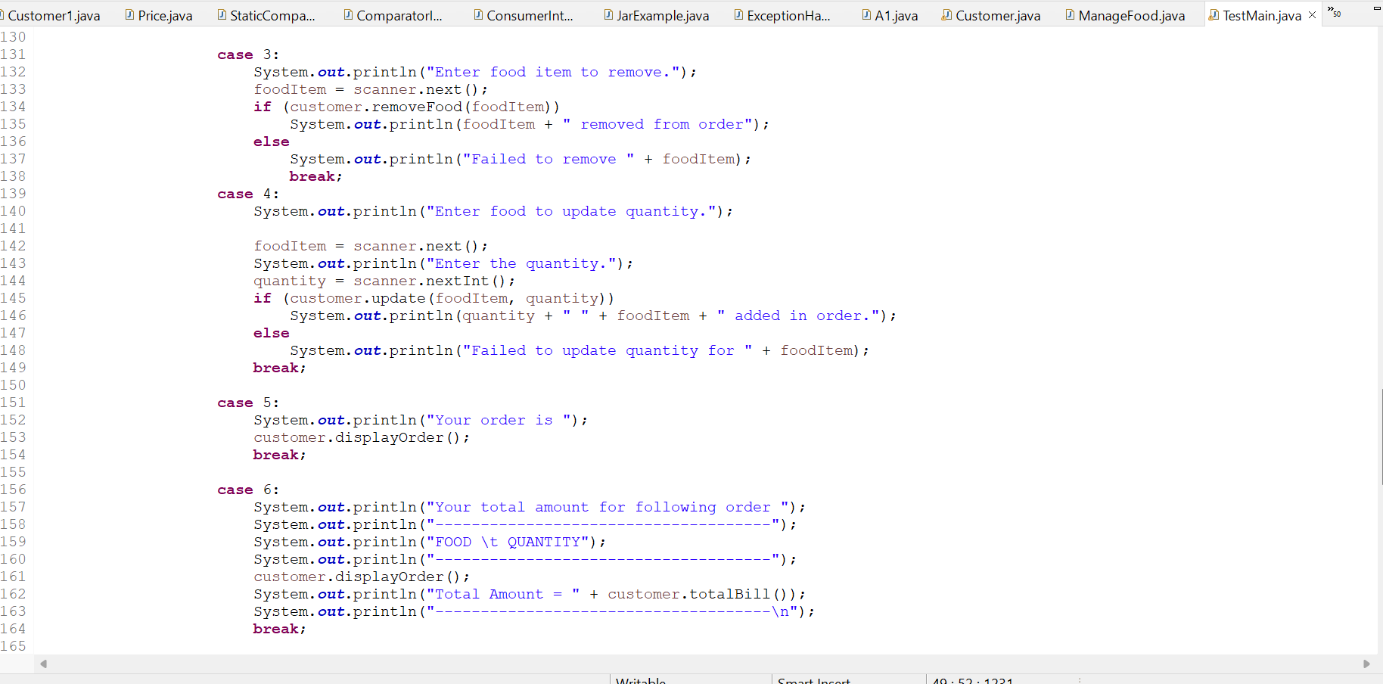

Slide 14
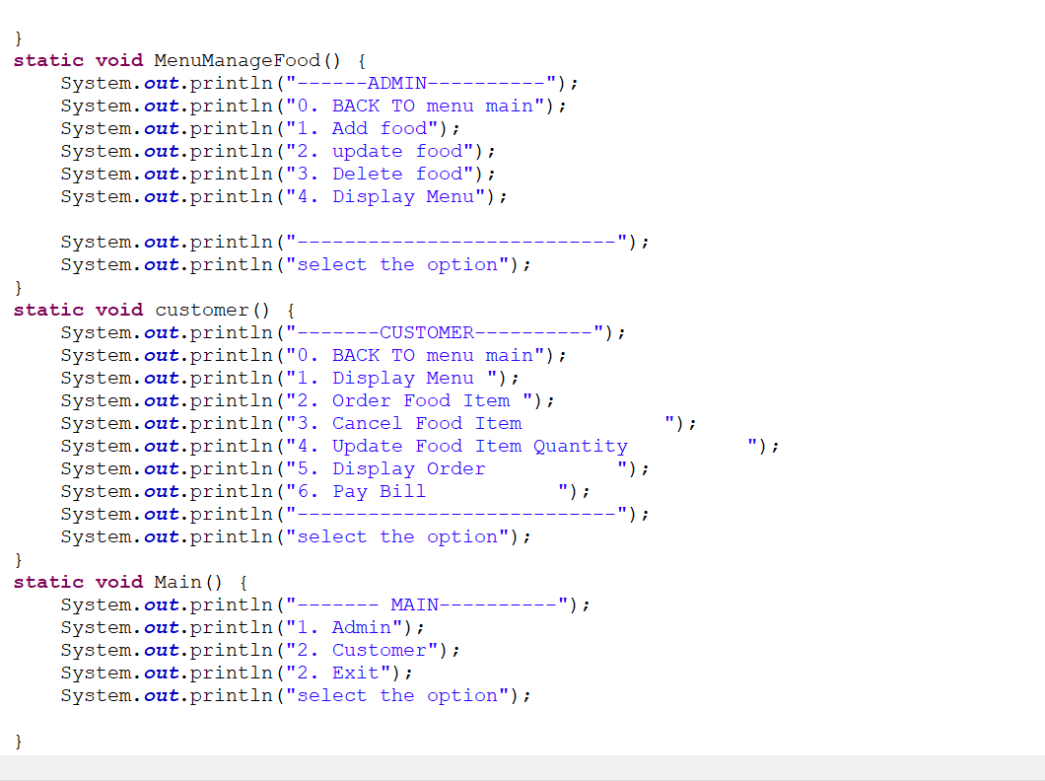

Slide 15
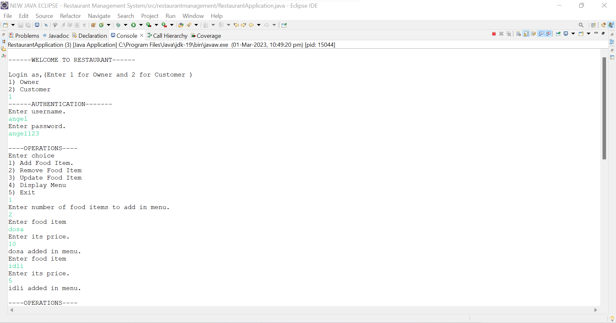
OUTPUT

Slide 16
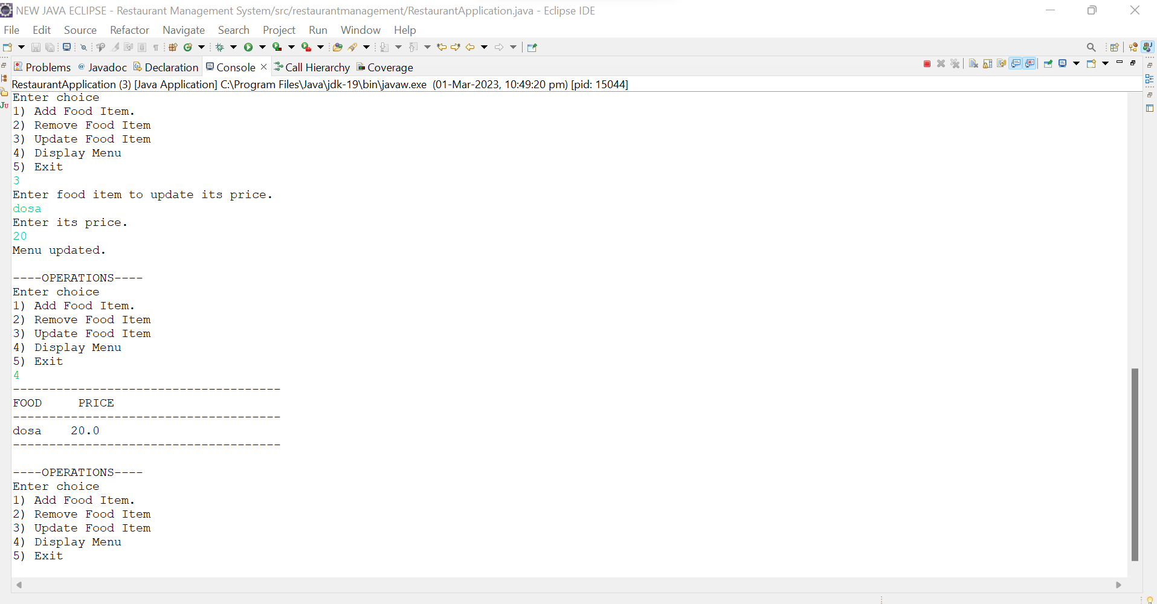

Slide 17
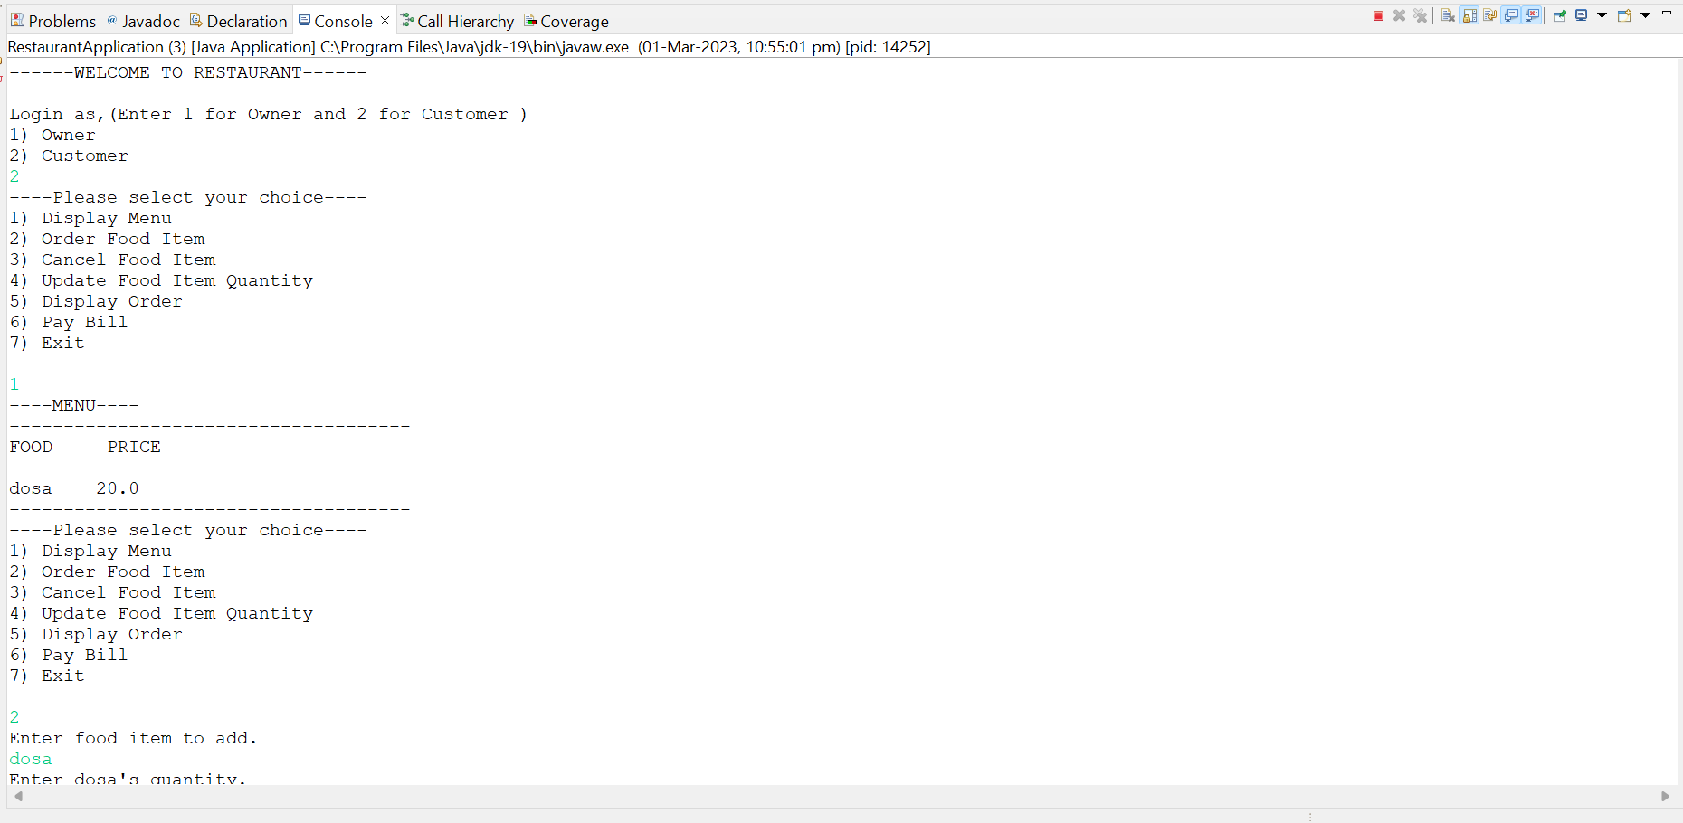

Slide 18
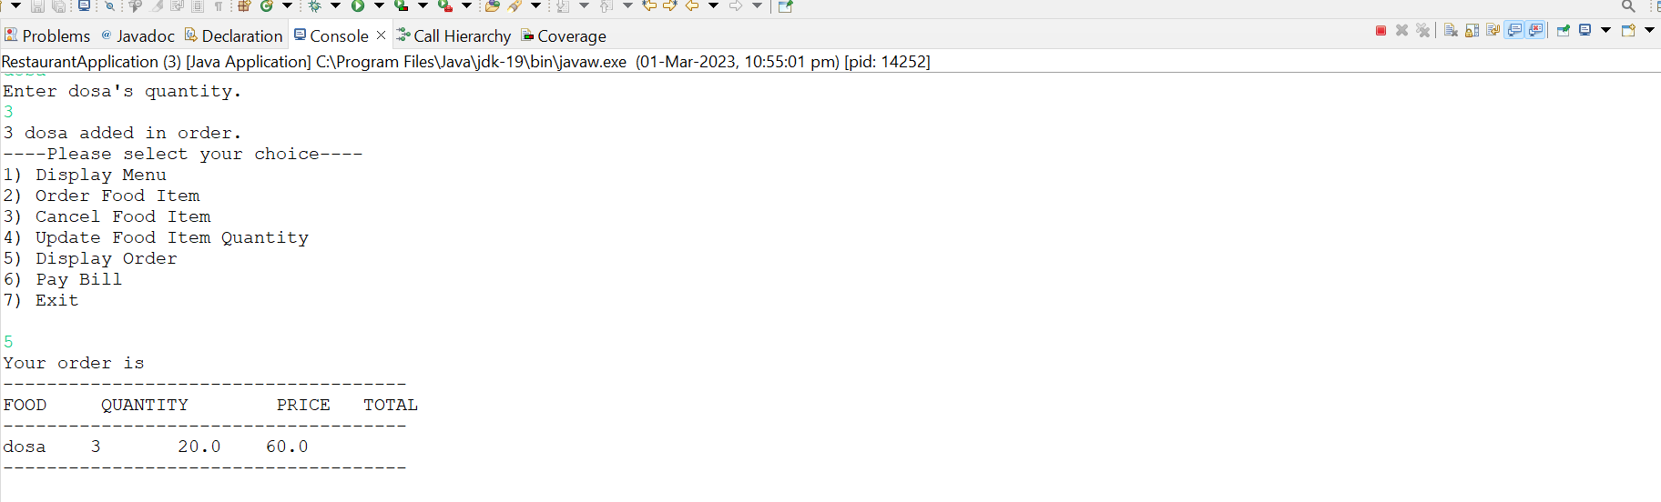
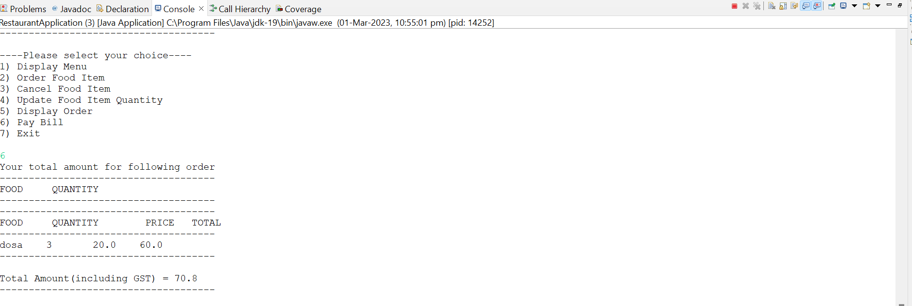

Slide 19
REFERENCES
https://javachain.com/java-hashmap-with-examples/
https://www.geeksforgeeks.org/hashset-remove-method-in-java/
https://www.geeksforgeeks.org/how-to-create-a-java-hashmap-of-user-defined-class-type/

Slide 20
CONCLUSION
In this project I have implemented “ Restaurant Management System”using java eclipse. This Application provides various options such as add,remove ,update and display and total bill. This Application give acess to both customers and restaurant owner.
In future , we can update this project by connecting eclipse to mysql.

